Slide 1
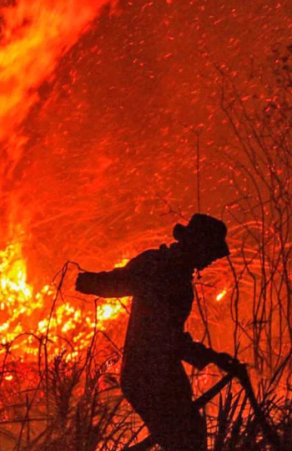
PREDICTING HOTSPOT INTENSITIES
Group ID: 3
Say Yueyang, Symus | He Zeqing | Kwek Yan Qing

Slide 2
TABLE OF CONTENTS
1
INTRODUCTION
2
MOTIVATION
3
PROPOSED SOLUTION
4
ANALYSIS
5
CONCLUSION

Slide 3
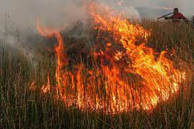
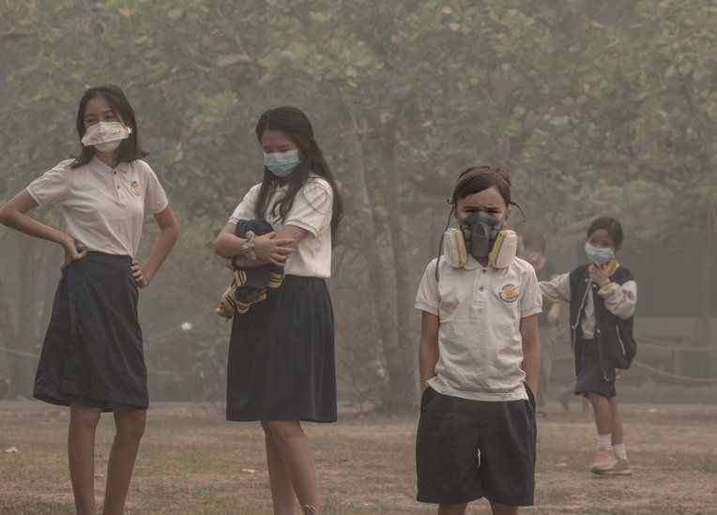
INTRODUCTION
Indonesia’s Forest Fires
Haze
Notes:
Haze is one major form of air pollution that Singaporeans face annually. The presence of haze is attributed to the forest fires in Sumatra, Indonesia. Due to the increase in demand of commercial crops, Indonesian farmers have resorted to shifting agriculture, which includes the large-scale slash-and-burn of forest land to produce fertile planting grounds. The resulting air pollution is then spread across the region by the climatic phenomenon El Nino, enveloping Singapore in a blanket of haze and affecting the overall health of Singaporeans. In 2020, Indonesia fires torched approximately 207,000 hectares of forests from January to September. While the area is smaller compared to previous years, the burning resulted in a US$5.2 billion cost towards the Indonesian economy, and the occurrence of toxic smog over the city.

Slide 4

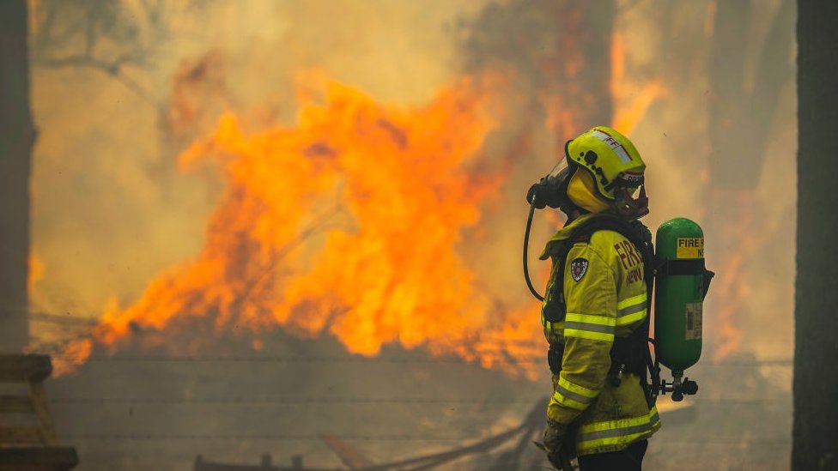
MOTIVATION
Brightness
data
Deploy firefighting teams
Prevent fires from escalating
Can we predict how intense a fire will be based on where it starts and how bright the fire burns?
Notes:
We want to see are able to predict how intense a fire will be based on location and brightness data captured by the satellite imaging. If there is a relation, we can utilize more satellites to detect fires and locate firefighters and agencies against slash and burn near places which tends to produce the worst fires.

Slide 5
PROPOSED SOLUTION
Data Acquisition and Visualization
Pre-processing
Generate Predictive Models
Compare Accuracy of Models
To predict Fire Radiative Power (FRP) from location and brightness data.
Notes:
We want to see are able to predict how intense a fire will be based on location and brightness data captured by the satellite imaging. If there is a relation, we can utilize more satellites to detect fires and locate firefighters and agencies against slash and burn near places which tends to produce the worst fires.

Slide 6

PROPOSED SOLUTION
Data Acquisition
NOAA-20 Satellite
VIIRS
Data extracted from NASA’s Fire Information for Resource Management System (FIRMS).
Dynamic data; near real-time (3h delay)
Dataset available: 24h/48h/7 days

Slide 7
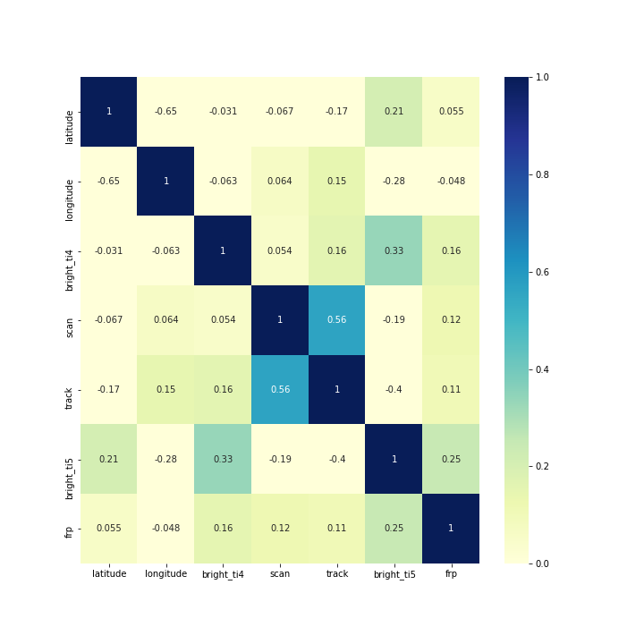
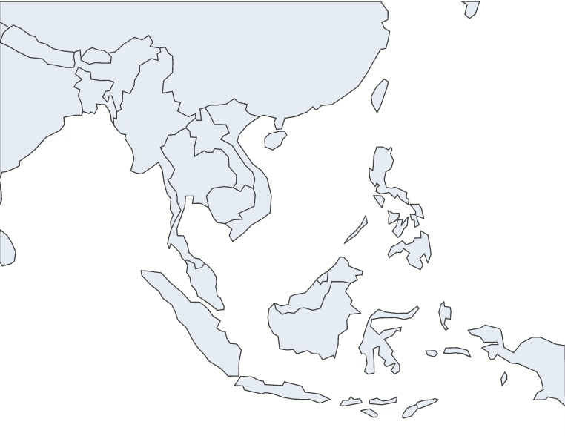
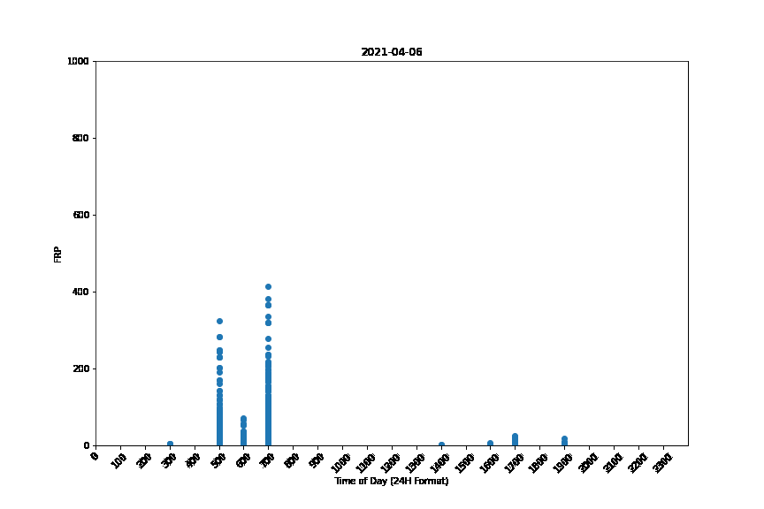
PROPOSED SOLUTION
Data Visualisation
Seaborn
Correlation Matrix, Scatter Plot
Plotly
Time-Series
Matplotlib
Time-Series (Hourly)

Slide 8
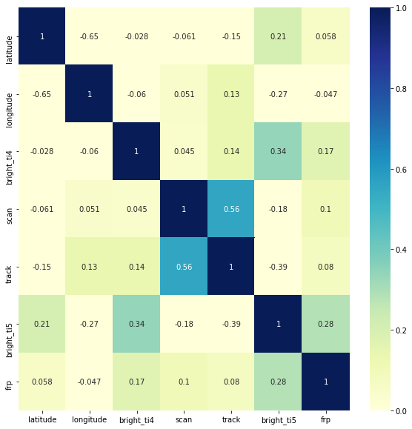
PROPOSED SOLUTION
Data Visualisation
Correlation Matrix
Observed correlation between Brightness and FRP
Observed correlation between scan and track (related to satellite movement)

Slide 9
PROPOSED SOLUTION
Data Visualisation
Time-Series Plot
Plot of FRP values for every satellite recording
Observed repeated/segmented data

Slide 10
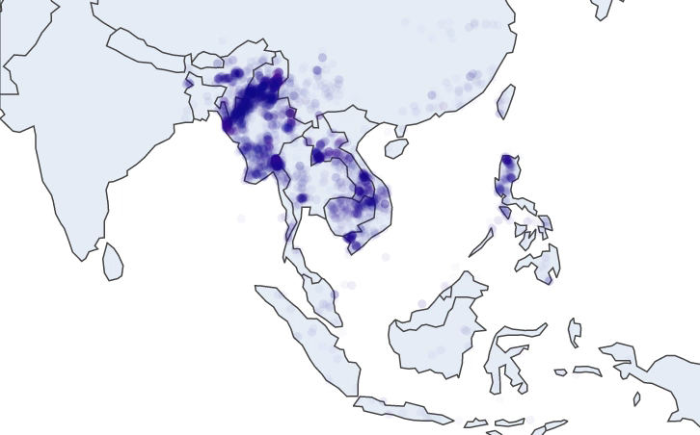
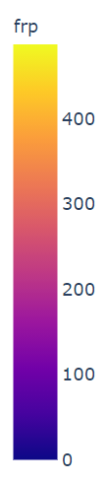
PROPOSED SOLUTION
Data Visualisation
Time-Series Plot
Plot of FRP values animated over every day
Observed concentration of fire data in same region

Slide 11
PROPOSED SOLUTION
Data Visualisation
Time-Series Plot
Plot of FRP values for every hour, animated over every day
Observed peaks at certain times of day

Slide 12
DATA PRE-PROCESSING Reformatting Features & Processing The Dataset
Reformatting Features
Reverse Geocoding with GeoPandas
One Hot Encoding (OHE)
Confidence
Daynight
Confidence_low
Confidence_nominal
Confidence_high
Daynight_D
Daynight_N
One Hot Encoding
Mixed Dataset
Binning Continuous Variables
Values produced: 0,1
One Hot Encoding
Binned Dataset
Notes:
4 | Data Pre-Processing
4.1 | Reformatting Features
Certain columns need to be reformatted into their appropriate data type for analysis.
In particular, we will be converting categorical data with multiple classfications into dummy variables where each category is a binary variable. To do so, we shall be using a tool known as OneHotEncoding (OHE).
# Convert 'object' columns into appropriate dtype
Confidence
Daynight
Time into integers

Slide 13
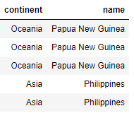
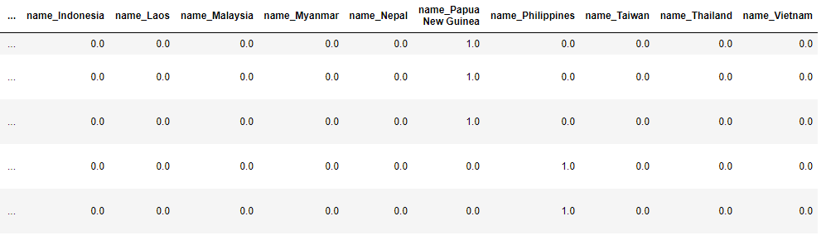
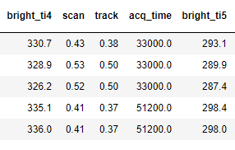
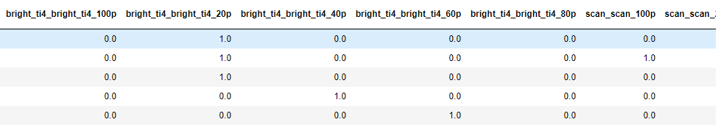
DATA PRE-PROCESSING Reformatting Features & Processing The Dataset
Dataset #1 – Conversion of Location to Binary Values
OHE
Dataset #2 – Conversion of Continuous Values to Binary Values
OHE
Notes:
4.2 | Processing the dataset
For better analysis, we wanted to process and convert elements of the dataset such that we had more uniform types of features. We ended up with two different datasets to use in our model.
4.2.1 | Adding location information (First dataset)
As our dataset was limited in useful features, we wanted to add supplementary information. Using a geopandas package, we were able to get more information about the location of the fire using latitude and longitude. We were able to add information like the country, continent and estimated population of in the area, which could be useful features to determine the intensity of the fire.
Also cleaned up any missing or NULL values
Conducted OHE, mainly on categories such as the continent and location name, as the values of the data are harder to utilise in our models
4.2.2 | Converting continuous features into categorical features (Second dataset)
To make the model more accurate, we attempted to convert continuous features into categorical features by splitting the datapoints into 5 bins of equally spaced out ranges of continuous data. We will then use OHE to convert these bins into dummy variables. This is so that we can simplify and standardize the type of features which is fed to the models by converting all the features (X) to binary variables. We will be training our models using this preprocessed fully categorical dataset, as well as the mixed ontinuous-categorical dataset.
Split into 5 percentiles with intervals of 20 each
Used OHE to convert into binary representations
4.2.3 | Dataset Summary
With that, we have 2 preprocessed datasets that we can use to train our models:
Mixed Dataset - Binary Features + Continuous Features Mix
Binned Dataset - All Binary Features

Slide 14
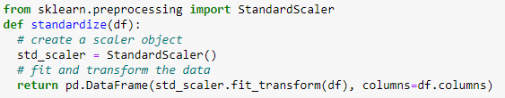
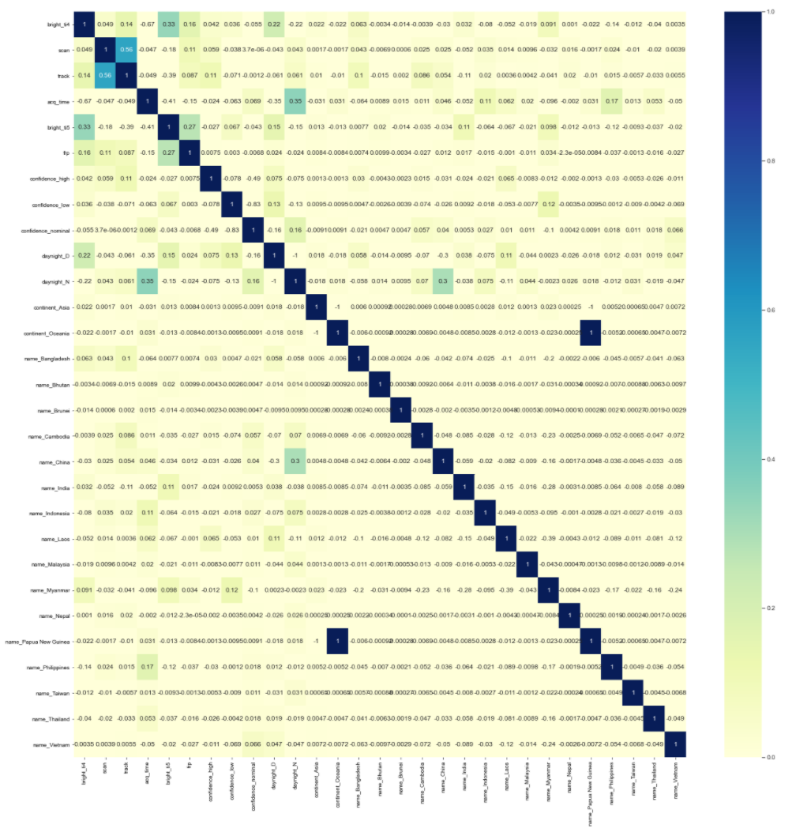
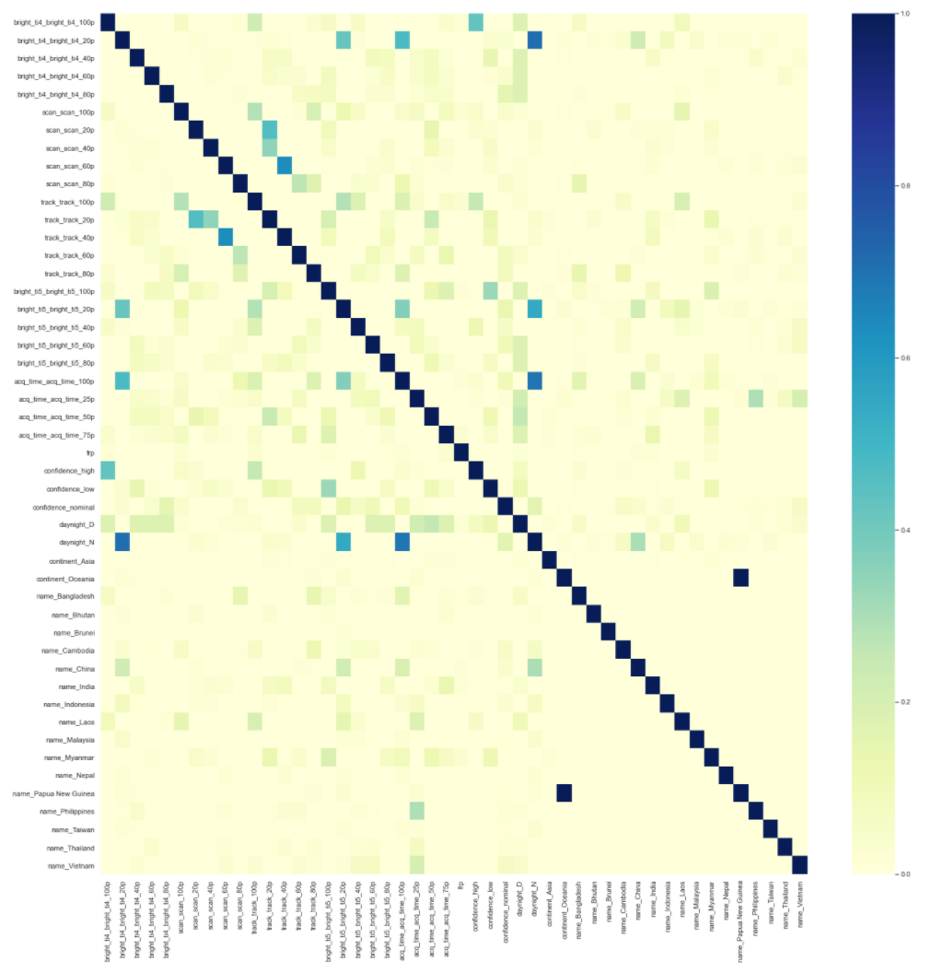
DATA PRE-PROCESSING Feature Selection
Correlation Matrix + Heatmap
Continuous + Binary Values
Binary Values
Notes:
4.3 | Feature Selection
With our two pre-processed datasets, we shall do some feature selection to make our models run faster and smoother.
4.3.1 | Covariance Matrix + Heatmap¶
Covariance Matrix for Mixed Dataset
To generate the covariance matrix for the mixed dataset, we first standardize the variables with sklearn’s standard scalar and plotted the heatmap
Out of all these relations, we would like to explore the relationship between brightness values and frp values for our project.
We also note that most of the variables are independent of each other, which is ideal for choosing dimensions which do not overlap for our function.
Due to the dynamic nature of our dataset, the values are subject to change

Slide 15
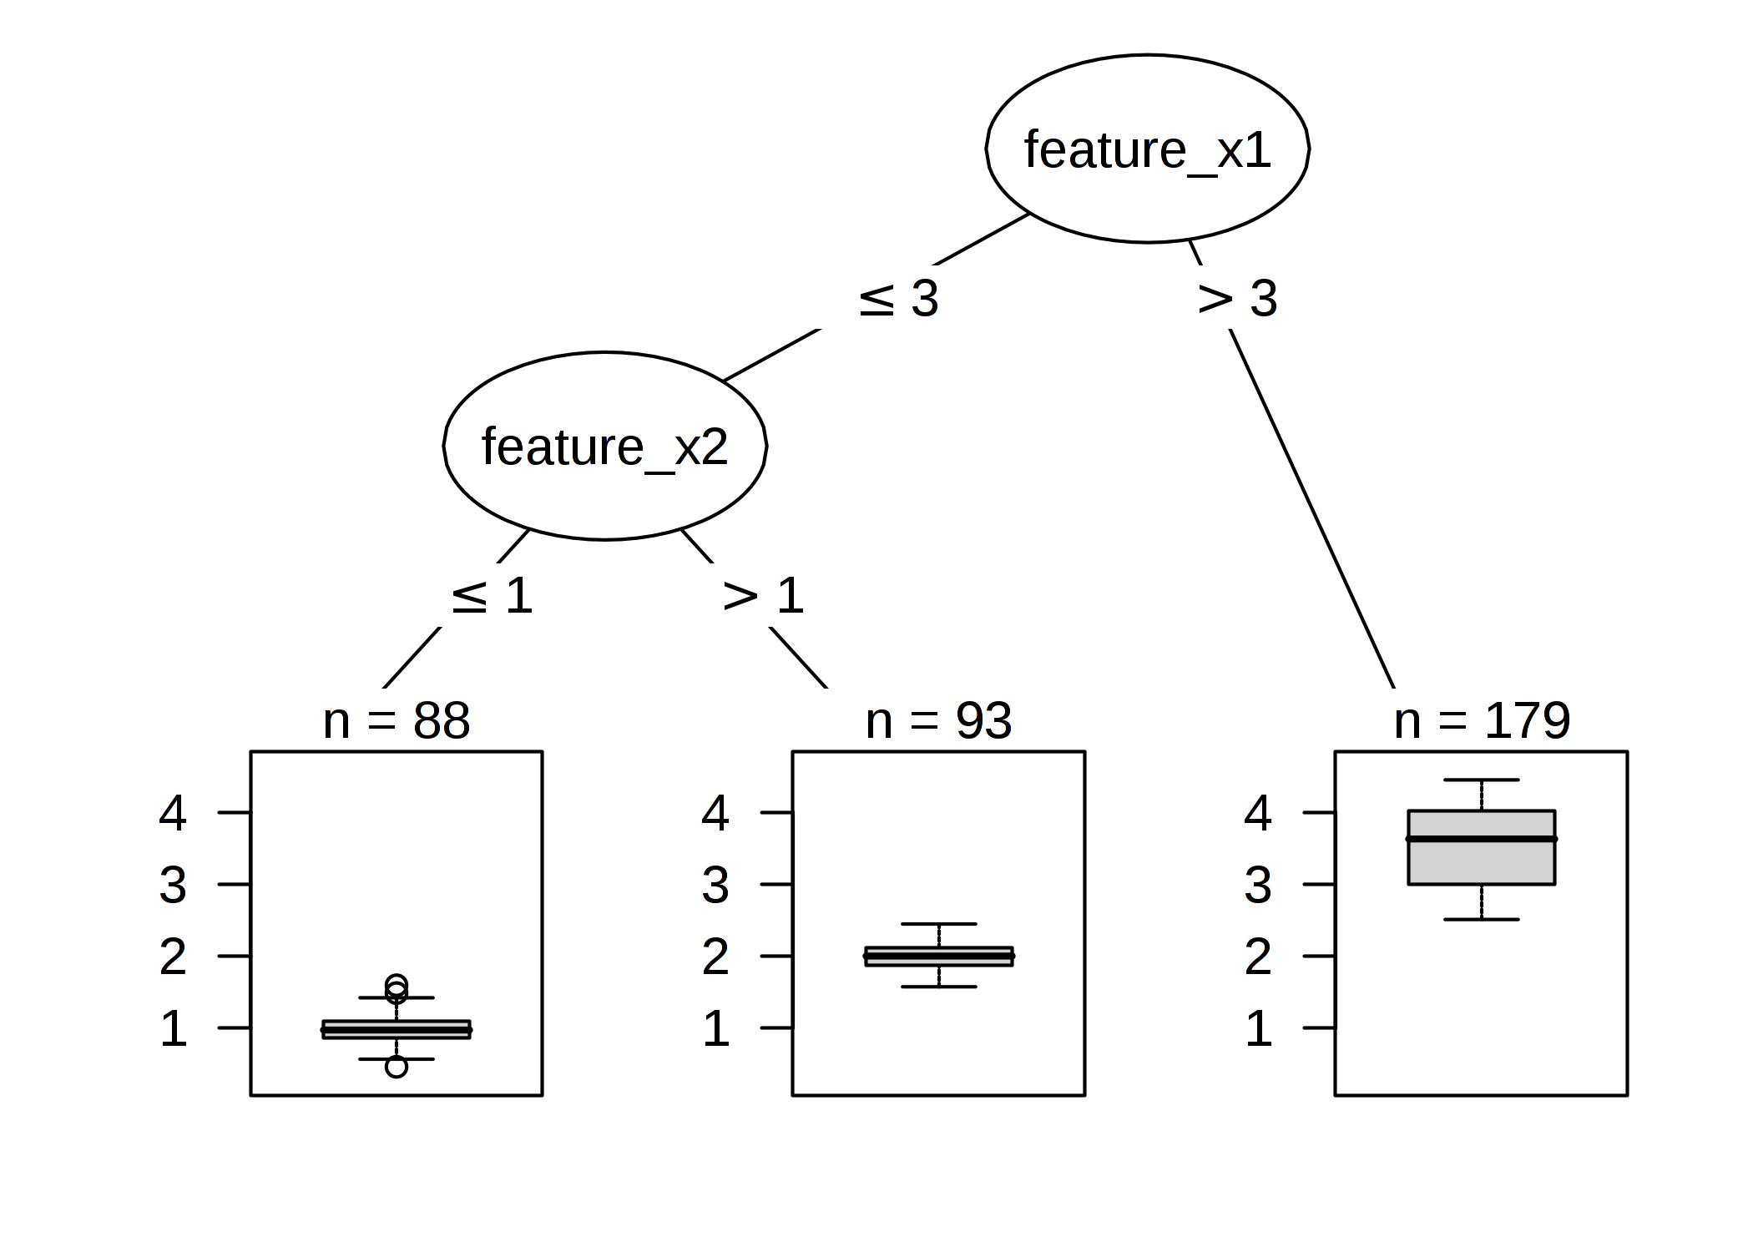

DATA PRE-PROCESSING Feature Selection
Random Forest Feature Selection Model
The top 3 factors correlating to the Fire Radiative Power are bright_ti5_bright_ti5_40p, bright_ti5_bright_ti5_80p, bright_ti4_bright_ti4_20p
The top 3 factors correlating to the Fire Radiative Power are bright_ti5, bright_ti4, scan
Notes:
4.3.2 | Random Forest Model
Another model we utilised is the Random Forest model, which comprises of a user-determined number of decision trees.
It works through the following steps:
A random sample is selected from the given dataset.
From this random sample, a decision tree is crafted. Assuming there are n random samples selected, there will be n decision trees. (The argument n_estimators allows the user to choose the value of n.)
When the Random Forest model makes a prediction, each decision tree will then produce a predicted result. Voting will commence for all n decision trees.
Once all n predicted results have been voted upon, the highest voted result is the final prediction.
The model has proven to be both accurate and robust due to the number of decision trees involved; additionally, due to it taking the average of all predictions by the decision trees, it is not affected by overfitting.
WE are only utilising this for the first dataset, containing both binary and continuous features, as the predictions of the binary dataset alone can overlap, with one feature but varying percentiles.

Slide 16
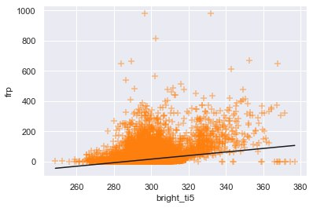
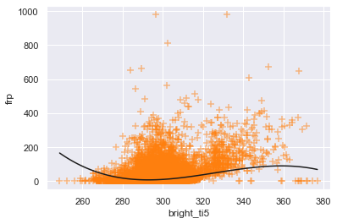
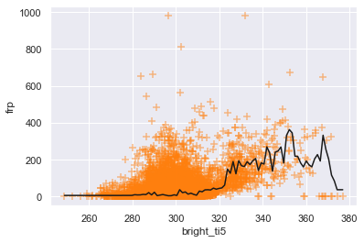

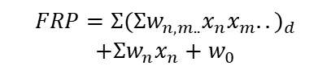
PREDICTIVE MODELLING Types of Models
Linear Regression
Poly Regression
Random Forest
$$FRP=Σw_{n}x_{n}+w_{0} \\ =Xw$$
$$FRP=Σ{(Σw_{n,m..}{x_{n}x}_{m}..)}_{d}$$
$$+Σw_{n}x_{n}+w_{0}$$
FRP =
mean of n (20) decision trees outputs

Slide 17
PREDICTIVE MODELLING Train-Val-Test Split
Linear Model
Polynomial Model
Random Forest Model
Test
Set
Train Set
Test
Set
Model parameters trained using Train Set
Evaluate Accuracy using Test Set
Train + Validation Set
4-fold Cross Validation:
Find ideal degree d
(hyperparameter)

Slide 18
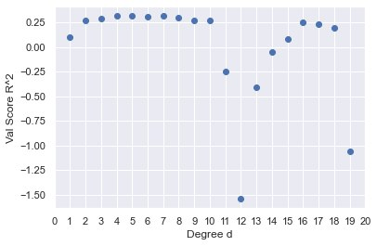
PREDICTIVE MODELLING Train-Val-Test Split

Slide 19
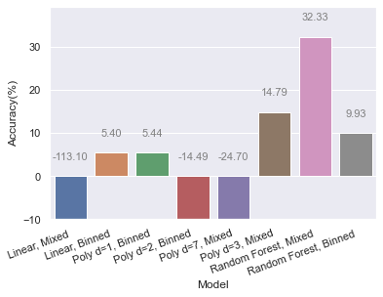
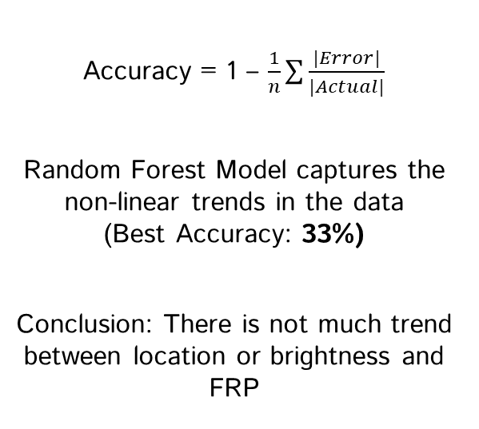
RESULTS AND ANALYSIS
Accuracy = 1 – $\frac{1}{n}\sum{\frac{|Error|}{|Actual|}}$
Random Forest Model captures the non-linear trends in the data (Best Accuracy: 33%)
Conclusion: There is not much trend between location or brightness and FRP

Slide 20
FUTURE IMPROVEMENTS
Use more data over longer periods
Find dataset with better features
Reduce the problem into classifying high FRP values versus low FRP values
Identify locations of interest and analyse location characteristics over a smaller area

Slide 21
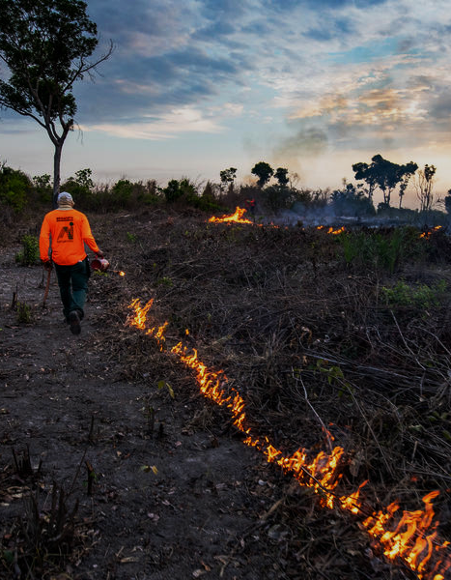

THANK YOU!
This project is available on GitHub!
Click on the logo to view it!
CREDITS: This presentation template was modified from a template by Slidesgo, including icons by Flaticon, and infographics & images by Freepik

Slide 22
CONTRIBUTIONS
Symus
Data Exploration
Data Visualization
Data Cleaning
One Hot Encoding
Atticus
Data Cleaning
One Hot Encoding
Feature Selection
Contextual Knowledge and Analysis
Formatting
Zeqing
Creating Models
Cross Validation
Evaluating Model Accuracy
Notes:
Data Exploration
Data Visualization
Data Cleaning
One Hot Encoding
Creating Models
Cross Validation
Evaluating Model Accuracy
Feature Selection
Video Editing
Presentation and Write Up

